Slide 1


Stripe Business Case
Data Pipelines for AI

Slide 2
Context
Tasks
Stripe: growing online payment processing platform
OLTP data model
OLAP data model
Increasing complexity of data management across platforms
NoSQL data model
Data integration architecture
Necessity to refactor the data infrastructure and pipelines
Security and compliance plan
Machine learning integration
Integration of the infrastructure with data sources and consumers
Example SQL and NoSQL queries

Slide 3
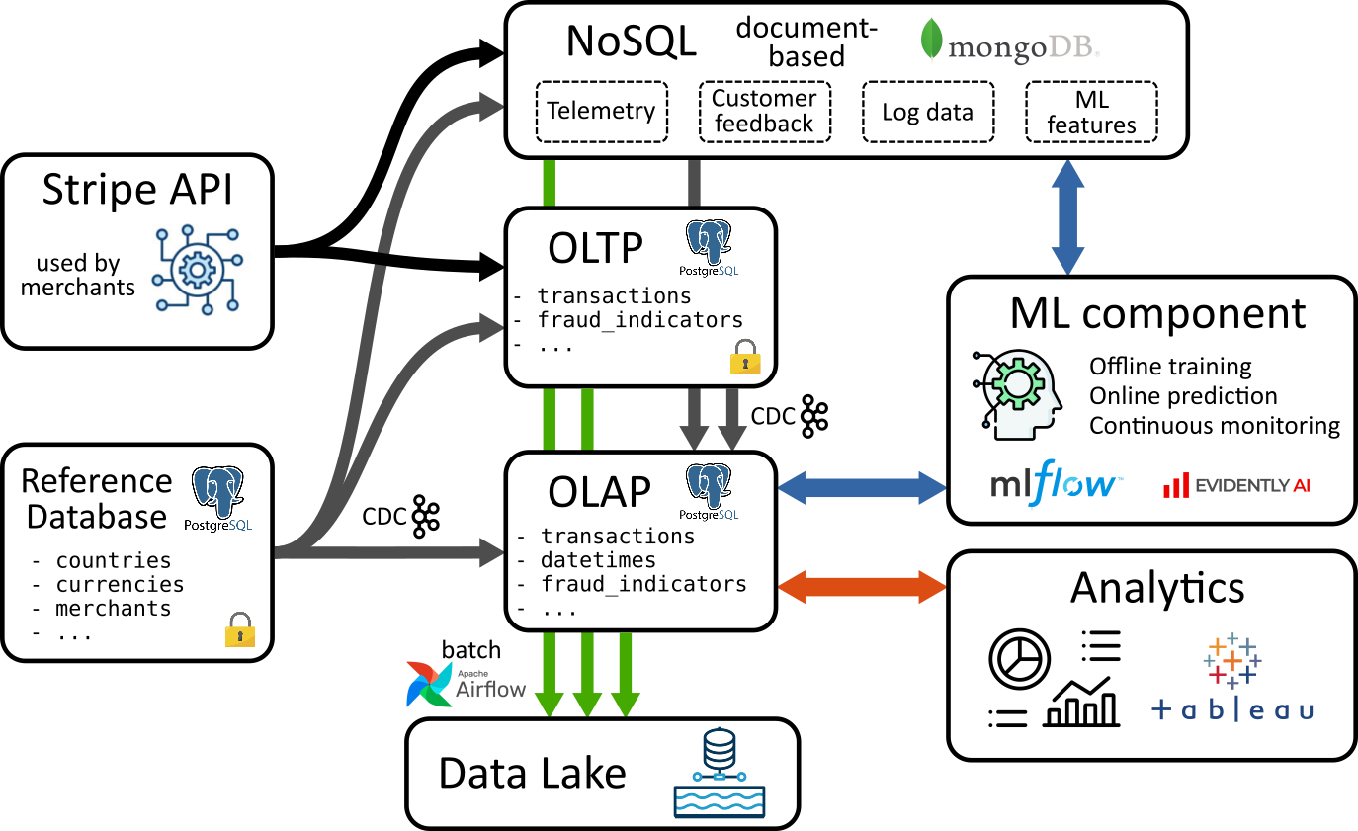
Pipeline architecture

Slide 4
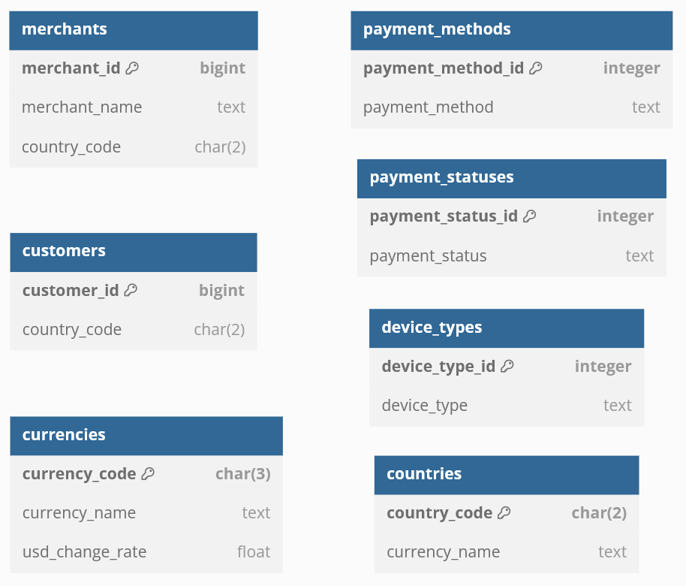
Reference Database
Slowly changing/static data
e.g., countries reference, merchants info, change rates
Source of truth for OLTP/OLAP/NoSQL
Updates propagated through Change Data Captures (CDC)
Holds sensitive information

Slide 5
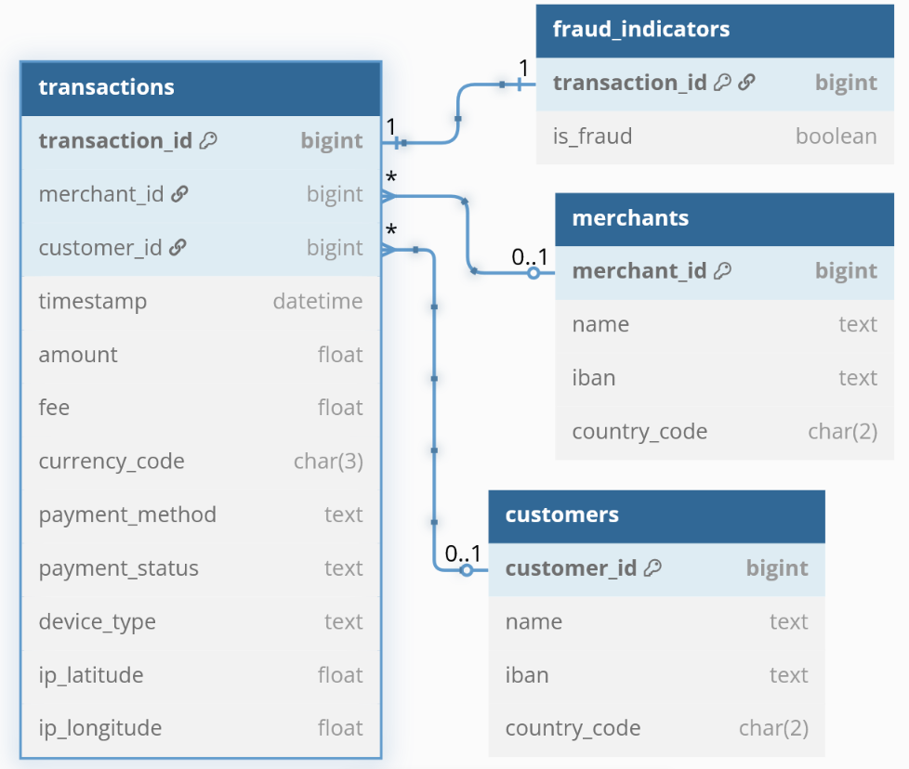
Online Transaction Processing (OLTP)
Core transactional operations: payments processed through Stripe API
High integrity, performance and reliabilty
Normalized schema (3NF)
Low redundancy, high consistency
ACID properties
Atomicity, Consistency, Isolation, Durability
Propagate downstream through Change Data Captures (CDC)
Holds sensitive information
- !!!

Slide 6
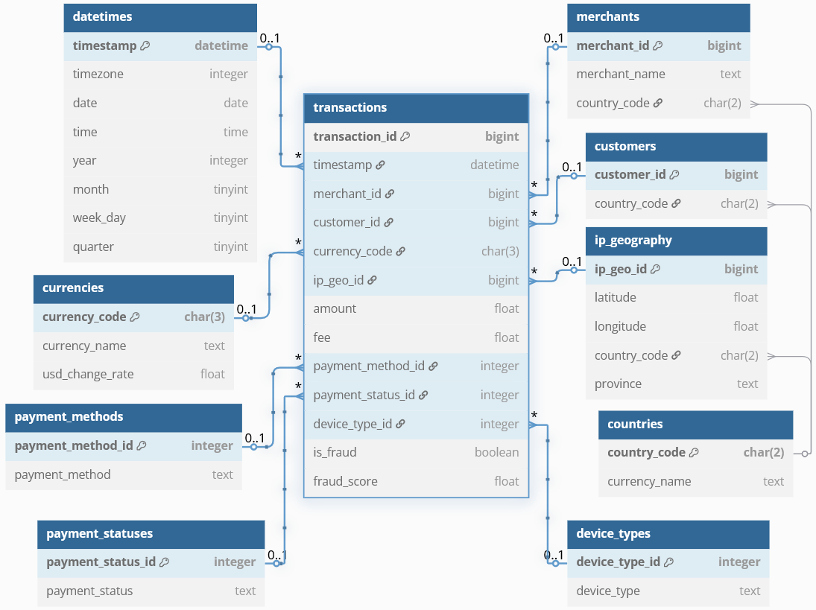
Online Analytical Processing (OLAP)
Analytical queries and BI
High availability, fast queries
Star schema architecture
transactions fact table
Pre-aggregations, views
for performance optimization
Connected to analytics and machine learning components
Low-sensibility information
- Anonymized data
- Access control and logging

Slide 7
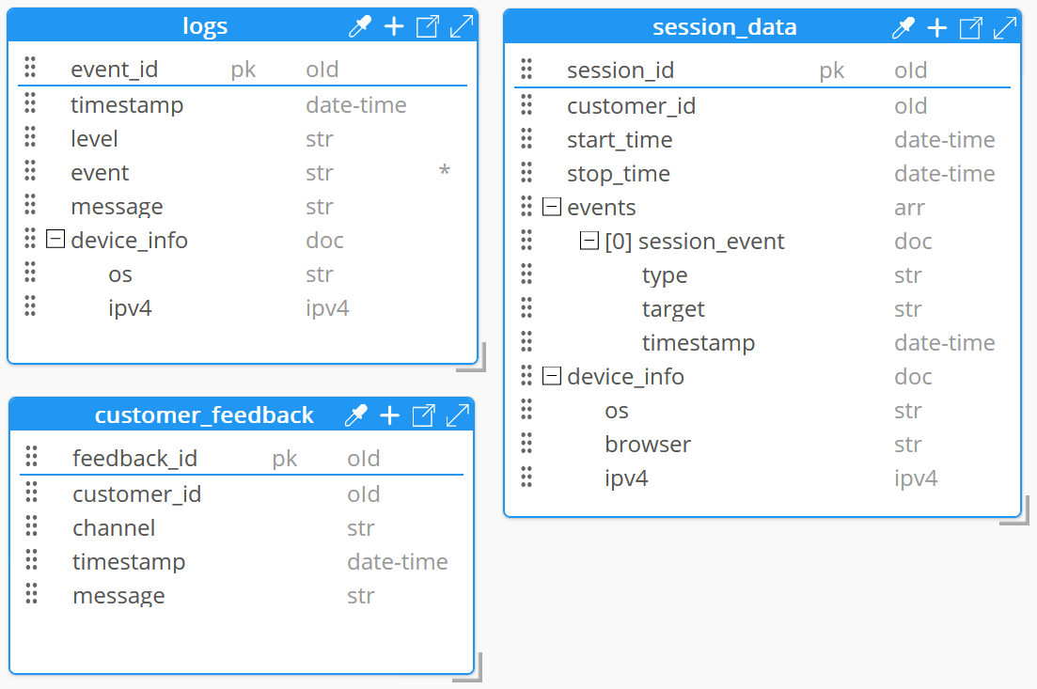
NoSQL Database
Document-based
High integrity, performance and reliabilty
Normalized schema (3NF)
Low redundancy, high consistency
ACID properties
Atomicity, Consistency, Isolation, Durability
Propagate downstream through Change Data Captures (CDC)
Holds sensitive information
- !!!

Slide 8
Machine Learning Integration
Core transactional operations: payments processed through Stripe API
High integrity, performance and reliabilty
Normalized schema (3NF)
Low redundancy, high consistency
ACID properties
Atomicity, Consistency, Isolation, Durability
Propagate downstream through Change Data Captures (CDC)
Holds sensitive information
- !!!

Slide 9

Thanks!

Slide 10












Pipeline architecture
Delay analysis data
Dashboard
API
EDA
Tracking server
Servers deployment on
Training
Pricing data

Slide 11
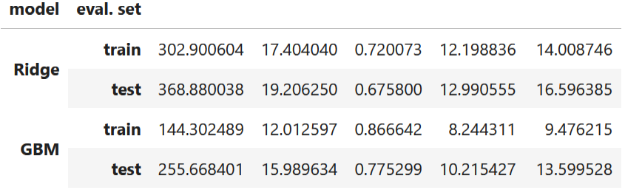
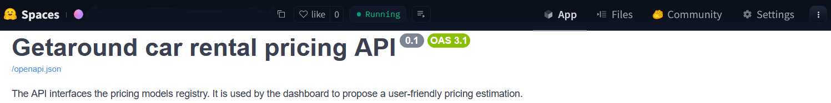
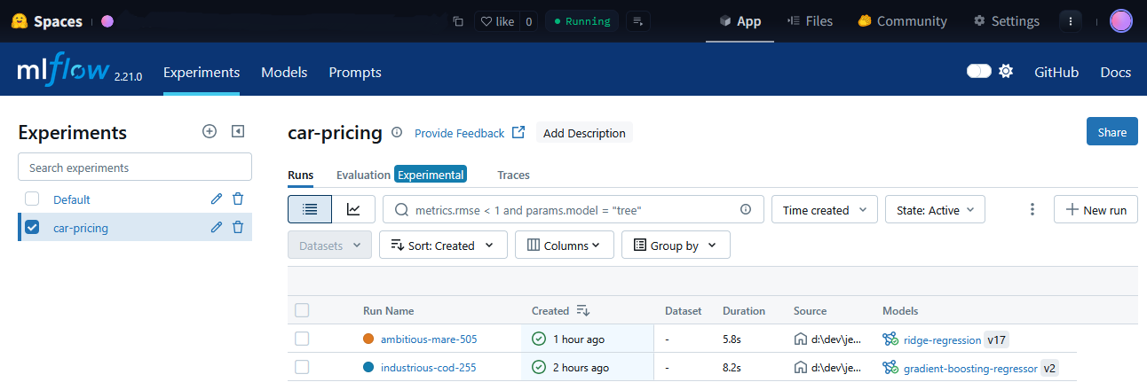
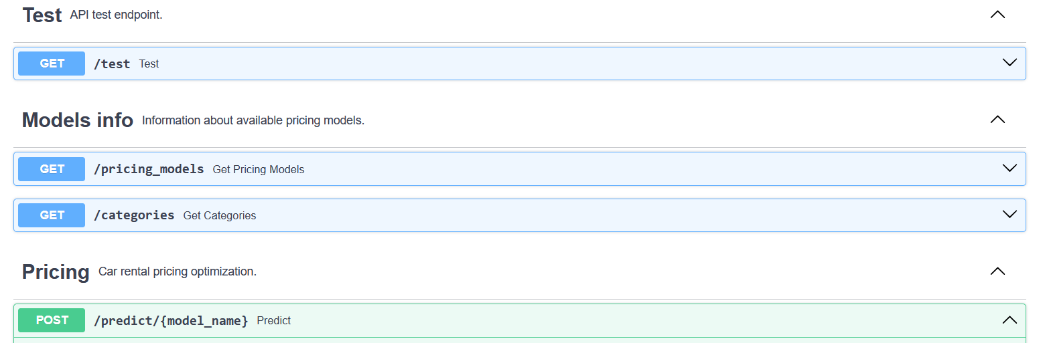
Pricing optimization API
Two pricing models
Ridge regression (Ridge)
Gradient boosting model (GBM)
Model training and tracking
Setup pricing API
Dispatch training on AWS EC2 instances
(MLflow project)
Registered models prediction endpoint
Provides additional model information
Track and record models in Mlflow server

Slide 12
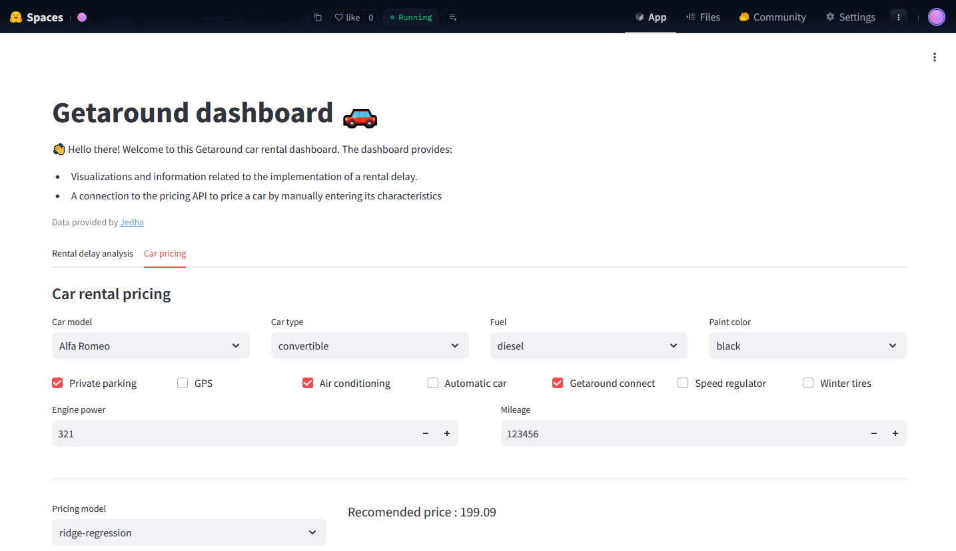
Dashboard : car rental pricing
Check API availability at startup
Fetch models info
Pricing evaluation from user input
(/predict endpoint)

Slide 13
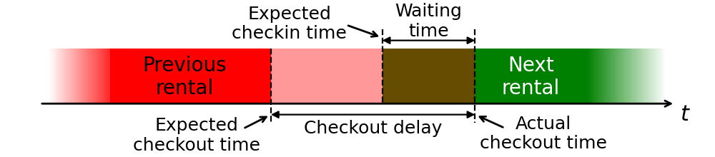
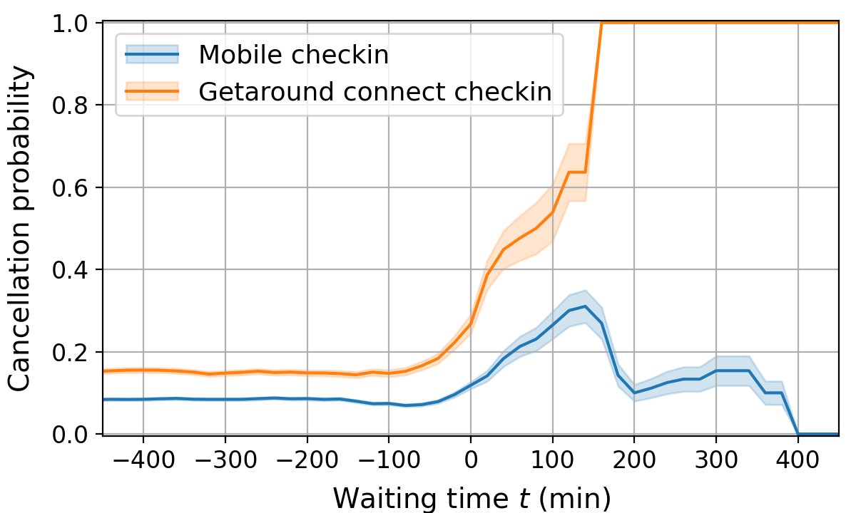
Rental delay analysis
Cancellation probability
Depends on waiting time
Depends on the checkin method
(Getaround connect or mobile)
Late car return problem
Cancel prob. when waiting time > t
Previous user is late
Car return delay may overlap with next rental
Creates friction if next user has to wait

Slide 14
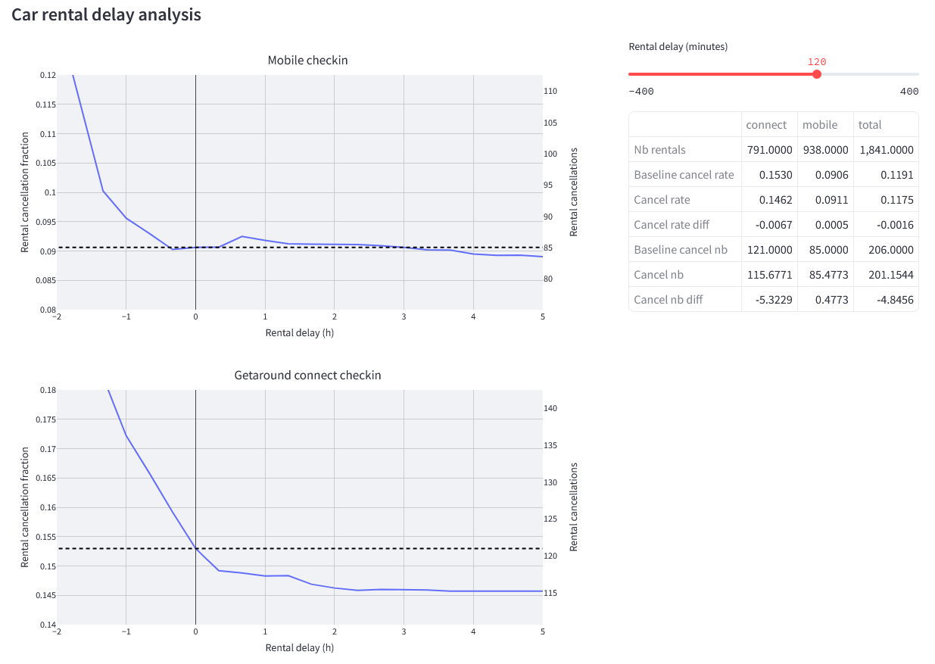
Dashboard : rental delay analysis
Visualize the effect of a rental delay
Cancellation probability
Both checkin methods
Summary table
Rental delay slider
Quantitative insights

